Slide 1
Security Documentation: Standards
Policies
Standards
Procedures
Guidelines
https://frsecure.com/blog/differentiating-between-policies-standards-procedures-and-guidelines/

Slide 2
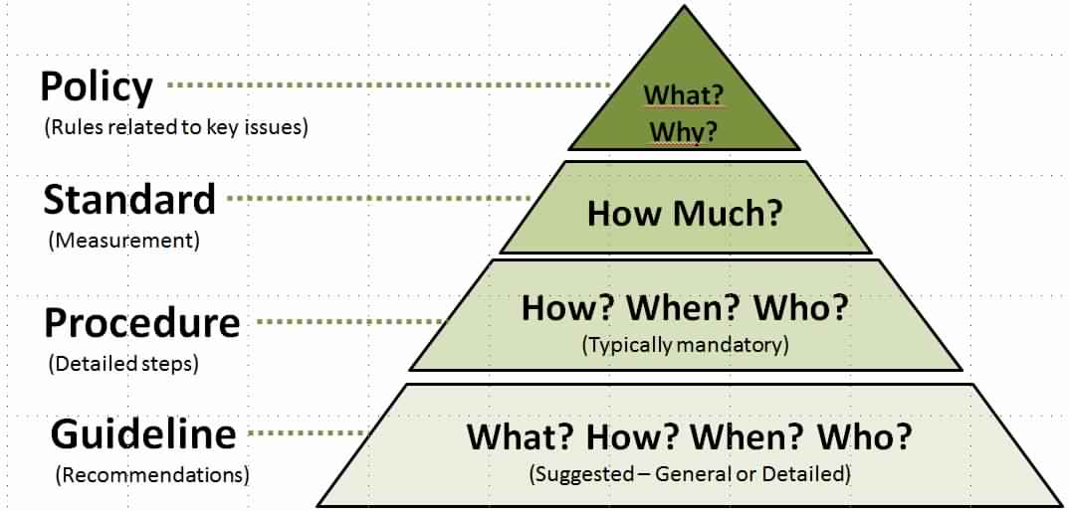
Security Documentation: Standards
https://frsecure.com/blog/differentiating-between-policies-standards-procedures-and-guidelines/

Slide 3
Security Documentation: Standards
Standards
Standards are mandatory actions or rules that give formal policies support and direction. One of the more difficult parts of writing standards for an information security program is getting a company-wide consensus on what standards need to be in place.

Slide 4
Security Documentation: Standards
Standards
This can be a time-consuming process but is vital to the success of your information security program.

Slide 5
Security Documentation: Standards
Standards
Used to indicate expected user behavior. For example, a consistent company email signature.

Slide 6
Security Documentation: Standards
Standards
Might specify what hardware and software solutions are available and supported.

Slide 7
Security Documentation: Standards
Standards
Compulsory and must be enforced to be effective. (This also applies to policies!)
END

